Slide 1
Botany and Plant Physiology
Lecture two
8th September 2025

Slide 2
Vegetative morphology of flowering plants-roots
The root is a vital organ of vascular plants, typically located below the surface of the soil. It serves multiple physiological and morphological functions. Roots develop from the radicle of the embryo and are non-photosynthetic.

Slide 3
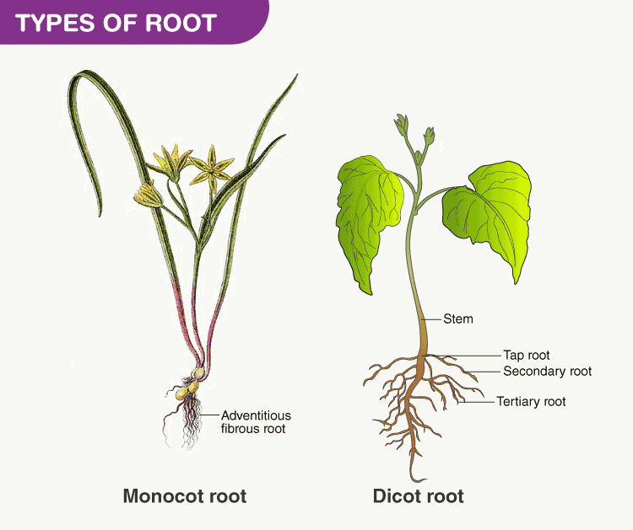

Slide 4
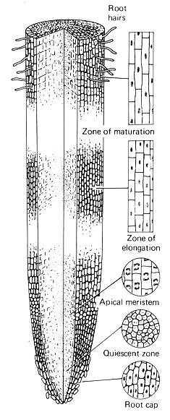
2.1 THE ROOT STRUCTURE
External structure of the root

Slide 5
2.1 THE ROOT STRUCTURE
External Structure
The root is divided into several regions/zones:
Root Cap (Calyptra)
  Protects the root apical meristem.
  Cells are produced by the root apical meristem and slough off as the root grows.
  Involved in gravitropism – the response to gravity.
Zone of Cell Division
  Includes the apical meristem.
  Actively dividing cells produce new root cells.

Slide 6
Zone of Elongation
  Newly formed cells elongate, pushing the root tip further into the soil.
Zone of Maturation (Differentiation)
  Cells differentiate into specialized types (e.g., epidermis, cortex, vascular tissue).
  Root hairs develop here to increase surface area for absorption.

Slide 7
Internal Structure (Anatomy of a Dicot Root)
Epidermis
  Outer layer; no cuticle; contains root hairs for absorption.
Cortex
  Made up of parenchyma cells; stores food; loosely packed for gas exchange.
Endodermis
  Innermost layer of cortex with Casparian strips (suberin bands) that regulate water flow into vascular tissue.

Slide 8
Pericycle
  Layer just inside the endodermis; gives rise to lateral roots.
Vascular Cylinder (Stele)
  Contains xylem (for water transport) and phloem (for nutrient transport).
  In dicots: Xylem is star-shaped; phloem is located between the arms.
  In monocots: Vascular bundles are arranged in a ring.

Slide 9
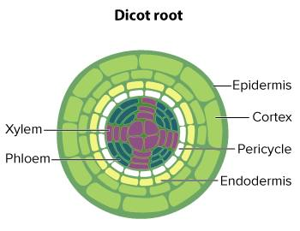
Internal structure of Dicot root

Slide 10
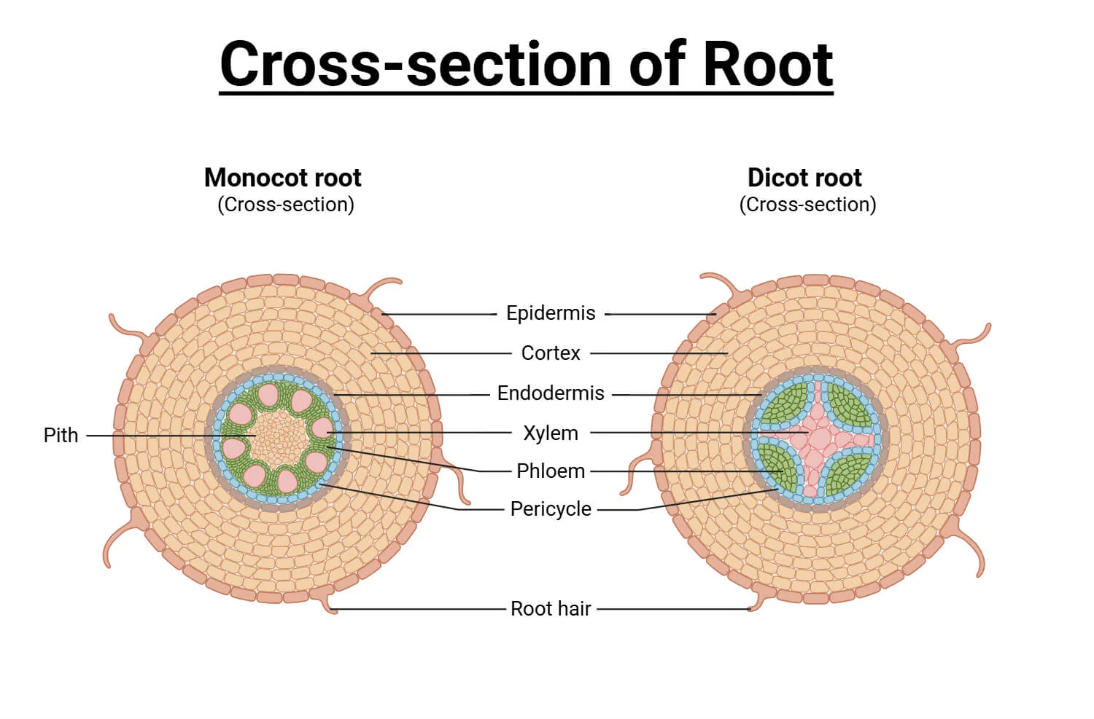

Slide 11
2.2 ROOT FUNCTIONS
Anchorage
  Roots firmly anchor the plant in the soil.
Absorption
  Root hairs absorb water and mineral nutrients from the soil.
Conduction
  Transport of absorbed nutrients and water to the shoot via xylem and phloem.
Storage
  Roots store carbohydrates and other nutrients (e.g., carrots, beets).

Slide 12
Hormone Production
  Roots produce plant hormones such as cytokinins and abscisic acid (ABA).
Symbiotic Associations
  Mycorrhizae: Fungi-root association to enhance nutrient uptake.
  Root nodules (e.g., in legumes): Housing nitrogen-fixing bacteria (Rhizobium).
Vegetative Propagation
  In some plants, roots can produce new shoots (e.g., sweet potato, dahlia).

Slide 13
2.3 ROOT SYSTEM
A root system refers to the complete set of roots developed by a plant. There are two main types:
1. Tap Root System
Origin: Develops from the radicle.
Structure: Has a main root (taproot) and lateral branches (secondary and tertiary roots).
Example: Dicots (e.g., beans, mango, mustard).
Function: Penetrates deep into the soil; efficient in anchorage and water absorption from deeper layers.

Slide 14
2. Fibrous Root System
Origin: Develops from stem tissue, not from the radicle.
Structure: A cluster of thin, thread-like roots that are all similar in size.
Example: Monocots (e.g., maize, wheat, grasses).
Function: Covers a wide area near the soil surface; excellent for preventing erosion.
3. Adventitious Roots
Origin: Arise from parts of the plant other than the radicle (e.g., stems, leaves).
Example: Banyan tree (from branches), maize (prop roots), sugarcane.
Function: Support (prop/stilt roots), storage, vegetative propagation.

Slide 15
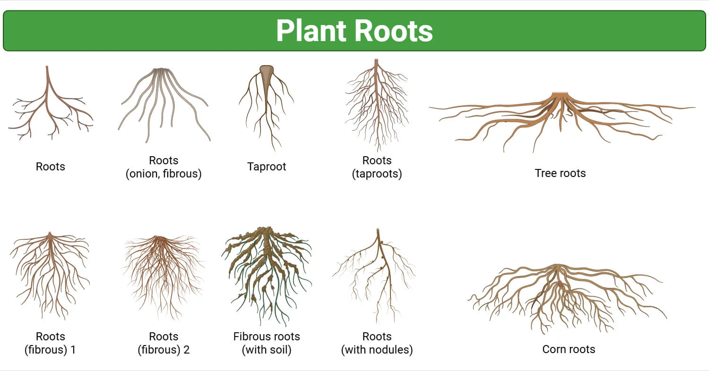

Slide 16
Summary Table
Feature | Tap Root | Fibrous Root | Adventitious Root
Origin | Radicle | Stem/base of stem | Non-radicle parts
Type of Plant | Dicots | Monocots | Both
Structure | One main root with branches | Many thin, equal-sized roots | Variable
Depth | Deep penetration | Shallow, widespread | Depends on function
Examples | Carrot, mango | Grass, wheat | Maize (prop roots), sugarcane

Slide 17
3.0 Plant Morphology – Stem and Leaf
Stems and the leaves, play vital roles in plant growth, survival, and adaptation of plants.

Slide 18
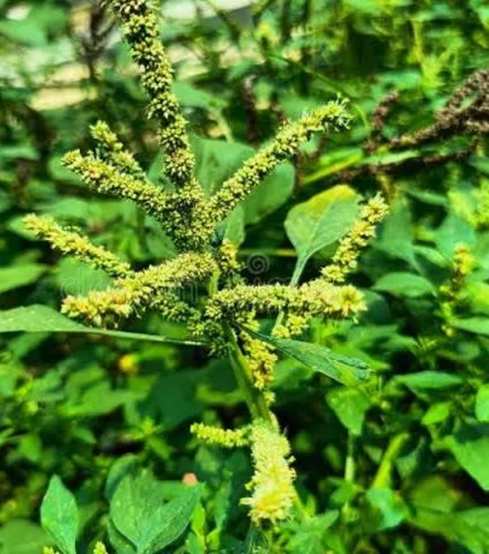
3.1 Stem Types, Stem Functions, and Modifications
A. Stem Types
Herbaceous stems – Soft, green, non-woody.
  Example: Amaranthus spp. (Doodo) – a common leafy vegetable in Uganda. They contain cellulose which is easily decomposed

Slide 19
Other examples of Herbaceous crops
Crop Name | Botanical Name | Notes
Maize | Zea mays | Staple food crop across Uganda
Sorghum | Sorghum bicolor | Drought-tolerant, grown in dry areas
Millet | Eleusine coracana | Important in Eastern & Northern Uganda
Rice | Oryza sativa | Grown in wetlands and irrigated areas

Slide 20
Woody stems – Hard, lignified stems that persist year after year.
  Example: Mangifera indica (Mango tree). Lignin takes a long time to decompose
Climbing stems – Adapted to climb supports.
  Example: Phaseolus vulgaris (Common bean) – climbs using tendrils.
Creeping stems – Grow horizontally on the ground.
  Example: Cynodon dactylon (Couch grass).

Slide 21
Woody plants/crops
Crop Name | Botanical Name | Notes
Mango | Mangifera indica | Common in central and eastern Uganda
Avocado | Persea americana | Grown in both home gardens and farms
Guava | Psidium guajava | Hardy tree, grown widely
Jackfruit | Artocarpus heterophyllus | Popular in central Uganda
Pawpaw (Papaya) | Carica papaya | Technically herbaceous-tree like, but often semi-woody
Citrus (Oranges, Lemons) | Citrus spp. | Grown in northern and eastern Uganda
Banana (Matooke) | Musa spp. | Pseudo-stem; not truly woody but often grouped with trees

Slide 22
Why Is Banana Sometimes Classified Under Woody Plants?
Banana (Musa spp.) is not a true woody plant, but it is often grouped with woody plants because of its large size, tree-like structure, and perennial nature — despite having no true woody tissue.

Slide 23
Botanical Structure
The banana "stem" is actually a pseudostem, made up of tightly packed leaf sheaths, not woody tissue (no lignin).
True woody plants develop lignified, secondary growth (true wood) from vascular cambium — bananas do not.

Slide 24
Tree-like Appearance
Bananas can grow 2–7 meters tall, resembling small trees.
Because of this tree-like form, they are functionally treated like woody perennials in farming systems, especially when classifying crops by structure or longevity.

Slide 25
Perennial Habit
Bananas live for multiple years, producing new suckers after harvesting.
This longevity and regrowth behavior is more like woody shrubs or trees than short-lived herbaceous plants.
No True Wood = Not Technically Woody
Bananas lack woody tissue (xylem with lignin).
Their stems cannot become hardened or produce bark.
Technically, bananas are large herbaceous monocots.

Slide 26
Summary
Feature | Banana | Woody Plant
Stem type | Pseudostem (leaf bases) | True stem with wood (lignin)
Woody tissue | ❌ None | ✅ Present
Tree-like size | ✅ Yes | ✅ Yes
Perennial growth | ✅ Yes | ✅ Yes
True wood/bark | ❌ No | ✅ Yes

Slide 27
So, bananas are not woody plants botanically, but are often grouped with them in agriculture due to size, longevity, and structure.

Slide 28
Shrubs
The stem type for shrubs is woody and persistent, meaning it is hard, durable, and remains above ground year after year, unlike the soft stems of herbaceous plants. Shrubs are characterized by having multiple stems branching from or near the base of the plant, which gives them a bushy, short-to-medium height appearance, distinguishing them from trees with a single main trunk

Slide 29
Examples of shrub crops
Shrub Crop | Botanical Name | Use | Region | Notes
Cassava | Manihot esculenta | Food (roots) | Widespread (esp. Northern) | Thick woody stems, used for propagation
Coffee | Coffea arabica, C. robusta | Beverage | Bugisu, Central, West | Grows as a pruned shrub for easier harvesting
Tea | Camellia sinensis | Beverage | Fort Portal, Bushenyi | Kept shrub-size by pruning
Hibiscus | Hibiscus sabdariffa | Herbal tea, medicinal | Scattered | Red-stemmed shrub with edible calyces
Pigeon pea | Cajanus cajan | Legume (protein source) | Eastern, Northern Uganda | Drought-resistant shrub, used in mixed farming
Black nightshade (Nakatti) | Solanum nigrum | Leafy vegetable | Central and East | Becomes semi-woody as it matures
Rosemary | Rosmarinus officinalis | Herb/spice | Gardens, herbal farms | Aromatic, woody shrub
Roselle | Hibiscus sabdariffa | Herbal tea | Similar to hibiscus | Used in Zobo and local drinks

Slide 30
B. Stem Functions
Support – Holds leaves, flowers, and fruits upright.
Transport – Conducts water (via xylem) and food (via phloem).
Storage – Stores nutrients or water.
  Example: Saccharum officinarum (Sugarcane) stores sugar in the stem.
Photosynthesis – In green stems.
  Example: Euphorbia spp., common in dry Ugandan areas.

Slide 31
C. Stem Modifications
Rhizomes – Underground horizontal stems.
Example: Zingiber officinale (Ginger).
Tubers – Swollen underground stems storing food.
Example: Solanum tuberosum (Irish potato).
Stolons/Runners – Horizontal stems above or just below the ground.
Example: Strawberry (Not native, but cultivated in Kabale).
Thorns – Modified stems for protection.
Example: Acacia spp., found in semi-arid areas like Karamoja.

Slide 32
3.2 Leaf Functions and Morphology
A. Leaf Functions
Photosynthesis – Main site for energy production.
Transpiration – Loss of water vapor through stomata.
Gaseous exchange – CO₂ in, O₂ out.
Storage – Some leaves store water or nutrients.
  Example: Aloe vera, used traditionally in Uganda.

Slide 33
B. Leaf Morphology
Blade (Lamina) – Broad, flat part.
Petiole – Stalk attaching leaf to stem.
Stipules – Leaf-like appendages at the base (not in all plants).
Venation:
  Parallel – e.g., Zea mays (Maize).
  Reticulate – e.g., Cassava, Beans.
Leaf types:
  Simple leaves – One blade (e.g., Mango).
  Compound leaves – Divided into leaflets (e.g., Cassava).
Leaf arrangement:
  Alternate, Opposite, Whorled (related to phyllotaxy).

Slide 34
3.3 Relationship Between Morphology and Environment
Plants adapt their structures (morphology) to their ecological conditions:
Examples:
Drought-prone areas (e.g., Karamoja):
  Plants like Acacia have small, thorny leaves to reduce water loss.
  Cacti (e.g., Euphorbia spp.) have succulent stems for water storage.
Wet/highland areas (e.g., Kabale):
  Large broad leaves in Colocasia esculenta (Cocoyam) to maximize photosynthesis.
Windy areas:
  Plants like Sorghum develop strong, fibrous stems for support.

Slide 35
3.4 The Concept of Phyllotaxy
Phyllotaxy: The arrangement of leaves on a stem or branch. It influences light capture, air flow, and photosynthetic efficiency.
Types of Phyllotaxy:
Alternate (spiral) – One leaf per node, alternating sides.
  Example: Sunflower, Maize.
Opposite – Two leaves per node, opposite each other.
  Example: Guava (Psidium guajava).
Whorled – More than two leaves per node.
  Example: Nerium (not native but cultivated).

Slide 36
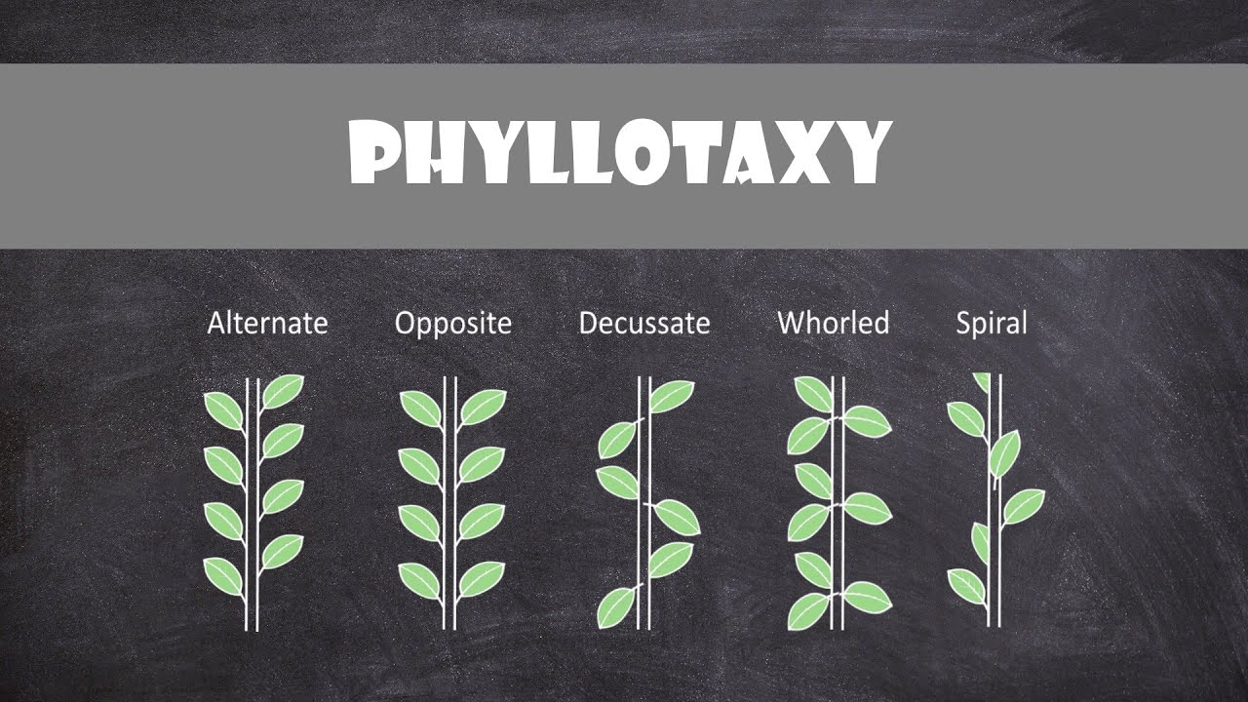

Slide 37
Significance of Phyllotaxy:
Maximizes sunlight interception.
Reduces self-shading.
Facilitates photosynthesis and growth in crowded environments.

